Slide 1
Flexible Bond 4Q25 Factsheet
December 31, 2025
Benchmark
Bloomberg U.S. Government/Credit Bond Index
Strategy Composite Inception
January 1, 1990
Attributes
Investment Grade
Duration of 3 to 8 Years
Downside Protection
Characteristics
Philosophy
  Challenge conventional thinking to discover real value.
  Develop unique economic perspectives by looking beyond single-point forecasts.
  Purchase inexpensive sectors and lock-in high yields or maintain short-duration portfolios when yields are low to reduce downside risk.
  In the long run, we believe undervalued securities will outperform the market.
Discovering Value
SKBA brings the investor a strategic array of value-based investment solutions, backed by perspective, process and performance. Our objective is to outperform our benchmarks while maintaining appropriate risk exposure.
The Flexible Bond strategy is a portfolio of U.S. dollar-denominated fixed income securities which seeks to produce interest income, to preserve capital, to offset the erosion in purchasing power due to price inflation, and to exceed the total return of the Bloomberg Government/Credit Bond Index. Only investment-grade government, agency, and corporate issues as rated by Duff & Phelps or Moody’s at the time of purchase are eligible for inclusion in the portfolio. The strategy team uses active interest rate anticipation and the analysis of quality spreads to determine the composition of issues held in a portfolio. The portfolio duration is set within a range of 3 to 8 years. Flexible Bond has been an active fixed-income strategy for SKBA since January 1, 1990.
| Composite Total Returns (%)
as of December 31, 2025
 | 4Q25 | One Year | Three Years | Five Years | Ten Years
Gross of Fees | 0.9 | 6.6 | 4.7 | 0.3 | 2.3
Net of Fees | 0.7 | 5.9 | 4.3 | -0.1 | 2.0
Bloomberg Gov't/ Credit Bond | 0.9 | 6.9 | 4.6 | -0.6 | 2.2
Performance for periods greater than one year is annualized. Past performance is not indicative of future results. Returns are calculated using a time-weighted return and include the reinvestment of all income. Gross of fee performance is reduced by any transaction costs. Net of fee performance is further reduced by actual management fees. Please refer to the GIPS Composite Report for additional details on the Flexible Bond composite.
Source: BondEdge
LBGC is the Bloomberg U.S. Government/Credit Bond Index

Slide 2
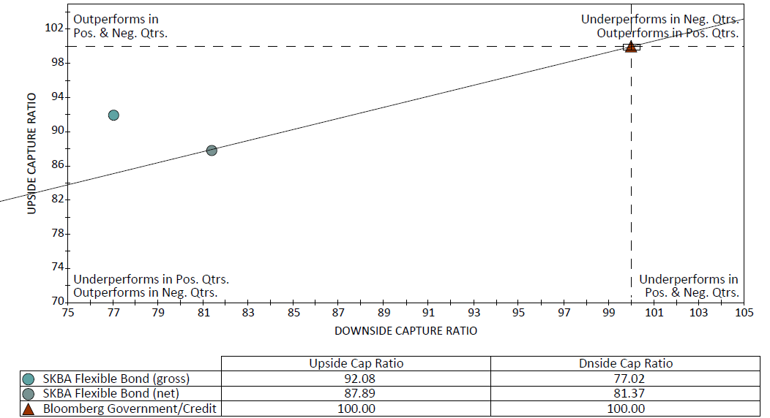
Flexible Bond 4Q25 Factsheet
December 31, 2025
Multi-Scenario Approach
SKBA employs a multi-scenario, conditional-probability framework that forecasts future states of the economy and financial markets over two-year and five-year horizons. We utilize five scenarios, which ranked from highest to lowest rate of inflation are called: Return of Inflation, Stagflation, Historic Norm, Perfection, and Deflation. The real GDP growth associated with each scenario follows a different pattern. For example, “Perfection” combines the highest real growth environment with low inflation (but not deflation), whereas “Stagflation” describes the nearly opposite environment consisting of low real GDP growth (albeit positive) and the second highest inflation environment. The growth rate of nominal GDP may be similar between these two scenarios, but the consequences for financial markets are dramatically different. This process is a unique analytical tool developed by SKBA and is a key part of the process that enables us to estimate what the interest rate changes, yield curve changes, expected returns for bonds, and the risk of loss in bond portfolios might be.
| Sector Diversification
Percent of total fixed income holdings. Due to rounding, figures shown may or may not sum exactly to 100%.
| 20 Year Upside vs Downside Market Capture – as of December 31, 2025
Source: PSN Database
Past performance is not indicative of future results. This information is deemed as supplemental information to the GIPS Composite Report of the Flexible Bond Composite which can be found can be found as page three. Up-market capture ratio is a measure of managers' performance in up markets relative to the market itself. An up market is one in which the market's quarterly return is greater than or equal to zero. The higher the manager's up-market capture ratio, the better the manager capitalized on a rising market. Down-market capture ratio is a measure of managers' performance in down markets relative to the market itself. A down market is one in which the market's quarterly return is less than zero. The lower the manager's down-market capture ratio, the better the manager protected capital during a market decline.
90 Day U.S. Treasury Bill
SKBA Capital Management
SKBA Capital Management, LLC is an independent San Francisco based boutique investment management firm founded in 1989. The firm manages equity and fixed income portfolios for institutions and private clients using its time-tested value investing approach seeking to preserve and increase clients’ capital while maintaining appropriate risk exposure and downside protection.
Reader should not assume that investments in the securities identified were or will be profitable. The securities identified and described do not represent all the securities purchased, sold or recommended for the client accounts. Holdings are subject to change. The fixed income Characteristics and Sector Diversification are based upon a representative account of the Flexible Bond Composite and included as supplemental information to this Composite and complements the attached GIPS Composite Report which complies with the requirement of the GIPS® standards. Moody’s rating agency is used for corporate bonds.

Slide 3
| Flexible Bond Composite GIPS Composite Report
* AUS is defined as assets that SKBA does not manage and where SKBA does not have investment or trading discretion. SKBA acts only as a research provider and our role is strictly to provide a model to unaffiliated investment advisers. The unaffiliated investment adviser determines how and when to act upon the recommended changes to the model portfolio. SKBA cannot place or effect a trade for any investor. AUS is estimated and is shown as supplemental information.
N.A. - Information is not statistically meaningful due to an insufficient number of portfolios in the composite for the entire year.
As of December 31, 2025, the 1-year net-of-fee composite return was 5.9%; the 5-year annualized net-of-fee composite return was (0.1%); and the 10-year annualized net-of-fee composite return was 2.0%. For the Bloomberg Government/Credit Bond Index, the 1-year return was 6.9%; the 5-year annualized return was (0.6%); and the 10-year annualized return was 2.2%.
Flexible Bond Composite contains all fee-paying institutional and tax-exempt discretionary accounts, both fixed-only and the fixed portion of balanced accounts, that employ SKBA's Flexible Bond strategy. The Flexible Bond strategy is a portfolio of U.S. Dollar-denominated fixed income securities that seeks to produce interest income, to preserve capital, to offset the erosion in purchasing power due to price inflation, and to exceed the total return of the Bloomberg Government/Credit Bond Index. At the time of purchase, only investment-grade government, agency, and corporate issues rated by Duff & Phelps or Moody's are eligible for purchase. The strategy team uses interest rate anticipation and the analysis of quality spreads to determine the duration (which is set between 3 and 8 years) and composition of the portfolio. For comparison purposes the composite is measured against the Bloomberg Government/Credit Bond Index. Index Data Source: Informa Financial Intelligence. As of January 1, 2000, institutional or tax-exempt accounts (including the fixed portion of balanced accounts) with $500,000 minimum market values at inception are included in this composite. The Flexible Bond Composite was created and incepted January 1, 1990.
SKBA Capital Management, LLC (“SKBA”) claims compliance with the Global Investment Performance Standards (GIPS®) and has prepared and presented this report in compliance with the GIPS standards. SKBA has been independently verified for the periods January 1, 1996 through September 30, 2025.
A firm that claims compliance with the GIPS standards must establish policies and procedures for complying with all the applicable requirements of the GIPS standards. Verification provides assurance on whether the firm’s policies and procedures related to composite and pooled fund maintenance, as well as the calculation, presentation, and distribution of performance, have been designed in compliance with the GIPS standards and have been implemented on a firm-wide basis. The Flexible Bond composite has had a performance examination for the periods January 1, 1990 through September 30, 2025. The verification and performance examination reports are available upon request. GIPS ® is a registered trademark of CFA Institute. CFA Institute does not endorse or promote this organization, nor does it warrant the accuracy or quality of the content contained herein.
SKBA, an investment advisory firm registered with the Securities & Exchange Commission, was founded in 1989 as an independent investment advisory firm. In 1999, SKBA became an affiliate of Convergent Capital Management LLC (“CCM”). In 2003 CCM was acquired by City National Corporation (“CNC”). Effective May 2011 SKBA employee shareholders bought back a majority controlling share of the business from CCM, with CCM Holdings III, LLC maintaining a minority stake. In November 2015, CNC was merged into RBC USA Holdco Corporation, which is a wholly-owned subsidiary of Royal Bank of Canada. As of December 31, 2021, the company repurchased the outside ownership interest of our former minority partner, CCM Holdings. As a result, SKBA is now owned 100% by employees and original founders. SKBA manages a variety of equity, fixed-income & balanced assets for U.S. institutional and high net worth clients. Firm assets under management are defined as all institutional & private client accounts managed by SKBA. A complete list of composite descriptions is available upon request.
Results are based on fully discretionary accounts under management, including those accounts no longer with the firm. Past performance is not indicative of future results.
Between January 1, 2010 and December 31, 2020, a significant cash flow (SCF) was defined as any inflow or outflow occurring during the calendar month which was equal to or greater than 35% of an account's beginning month value.
The 2024 Composite Assets were updated from $4.6M to $6.3M during 2Q25. In presentations from January 2025 – April 2025 the previous asset value was included in the GIPS Composite Report.
The Bloomberg Government/Credit Bond Index monthly return for August 2023 was updated from (0.04%) to (0.59%) during 1Q25, resulting in the 2023 annual return changing from 6.31% to 5.72%. The 5-year and 10-year annualized returns changed from (0.1%) to (0.2%) and 1.6% to 1.5%, respectively. In presentations from January 2024 – March 2025 the prior returns were included in the GIPS Composite Report.
The U.S. Dollar is the currency used to express performance. Returns are calculated using a time-weighted return and include the reinvestment of all income. Gross of fee performance is reduced by any transaction costs. Net of fee performance is further reduced by actual management fees. The annual composite dispersion is an asset-weighted standard deviation calculated for the accounts in the composite the entire year. All risk measures presented in this report are calculated using gross-of-fee returns. Policies for valuing investments, calculating performance, and preparing GIPS reports are available upon request.
Standard Fee Schedule: For accounts up to $25 million: 0.30% on the first $3 million, 0.25% on the next $12 million, 0.20% on the next $10 million. For accounts over $25 million: 0.20% on the first $25 million, 0.15% on the next $75 million. Actual investment advisory fees incurred by clients may vary.

